Slide 1
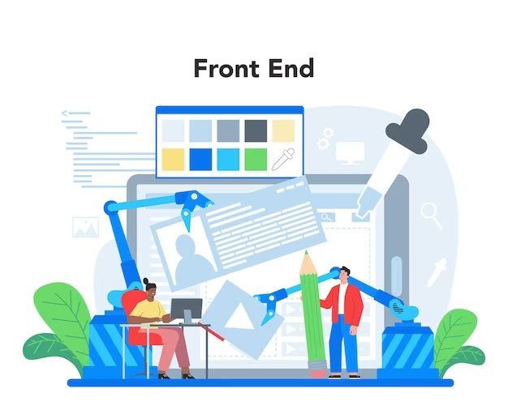
| Front End Engineering-I Project |
Team Details:
Project Group No. : PG-14
Arshdeep Singh (2310990129)
Arpit Uppal (2310990128)
Arpan (2310990127)
Arshita (2310990130)
Faculty Coordinator:
DR. AMANDEEP KAUR
Chitkara University Institute of Engineering and Technology,
Chitkara University, Punjab

Slide 2

:- Table of Contents -:
Introduction
Problem Statement
Technical Details
Key Features
Project Highlights
Bonus Feature(optional)
Conclusion
References/Links used

Slide 3

| Introduction |
SEO-FRIENDLY WEBSITE
The project titled “SEO-Friendly website“ is about SEO (Search Engine Optimization ) and SERPs (Search Engine Results Page) which enhances the productivity and organic network traffic over websites
Theoretically, Any website may become SEO friendly ! Thus we had a wide range of ideas to choose from, which lead to the creation of our very own grocery website “The Groco”

Slide 4
| Problem Statement |
About 10,000+ new E-commerce websites are created every year in India alone. Yet all of them fade away in dust. Big bulls like Flipkart and Amazon have dominated the Indian e-commerce search. So what is wrong with other E-commerce sites ?

Slide 5

| Technical Details |
The project uses HTML (version: HTML 5) ,
CSS (version: CSS 3) and minor
JAVASCRIPT (version: ES13)
The project uses GOOGLE CHROME (version:116.0.5845.188) as the default browser and reference browser
The code editor used during the creation of the project is VS Code (version: 1.78)
The project uses GitHub as the Version Control System (version: 3.10.2)
The project also uses Google fonts (Poppins)
and swiper.com official site (swiper effect)

Slide 6

| Key Features |
To tackle this problem we need :
Foremost , An E-commerce website
Unique ids which separate each individual element
The appropriate usage of keywords to emphasize the element for easier SEO
The usage of appropriate meta tags
To make the website mobile friendly as well
Use of proper head , title and meta description tags
Use of keyword-rich anchor text in your links

Slide 7
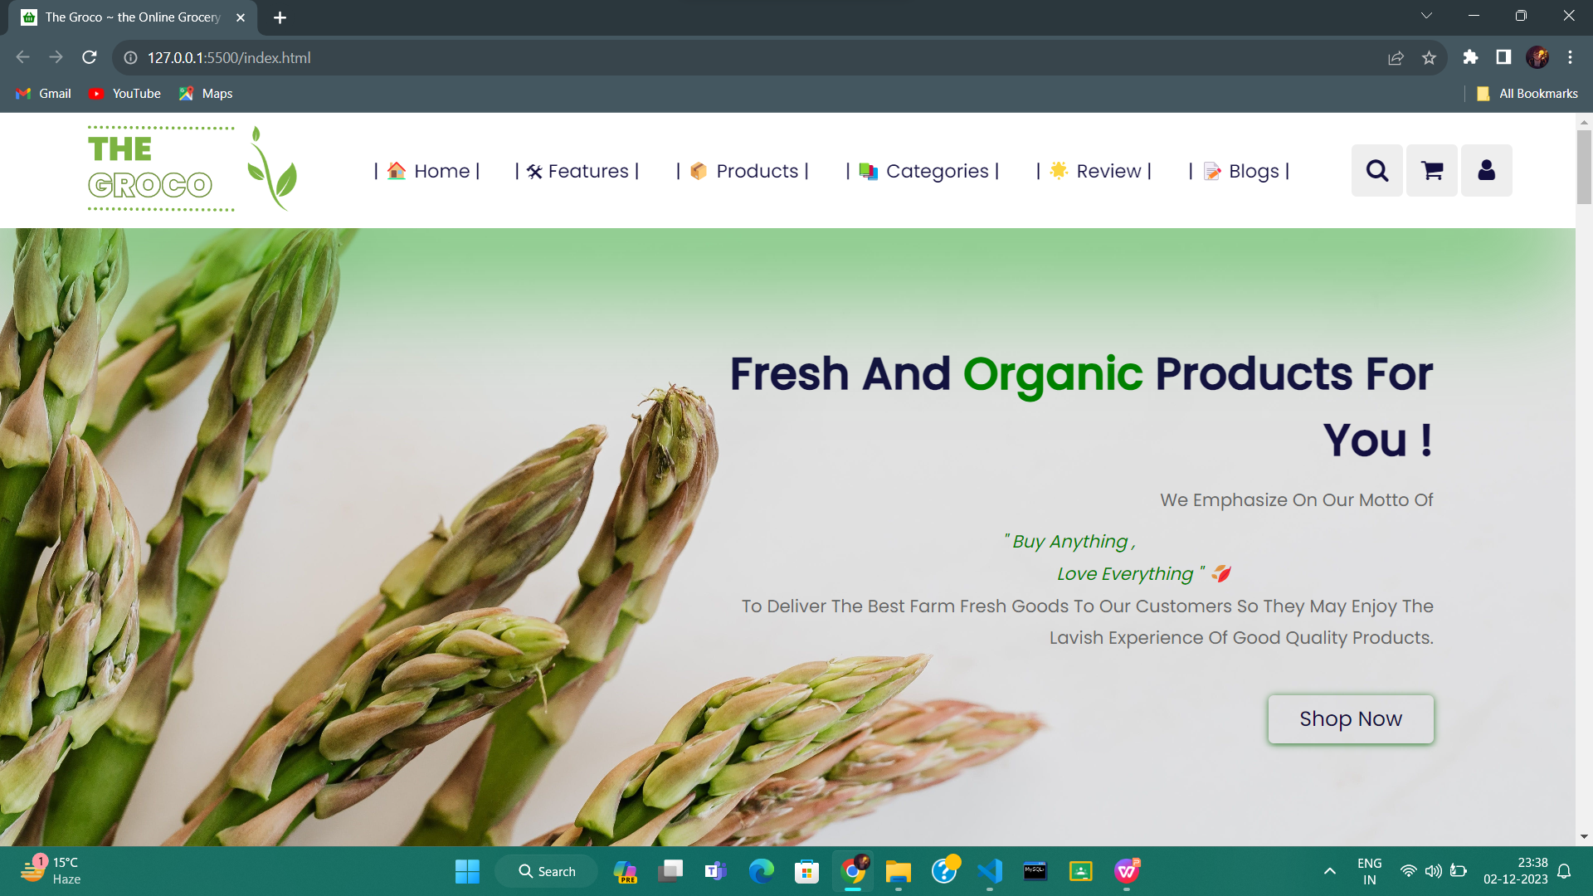
| Project Highlights |
This is the title page of our project

Slide 8
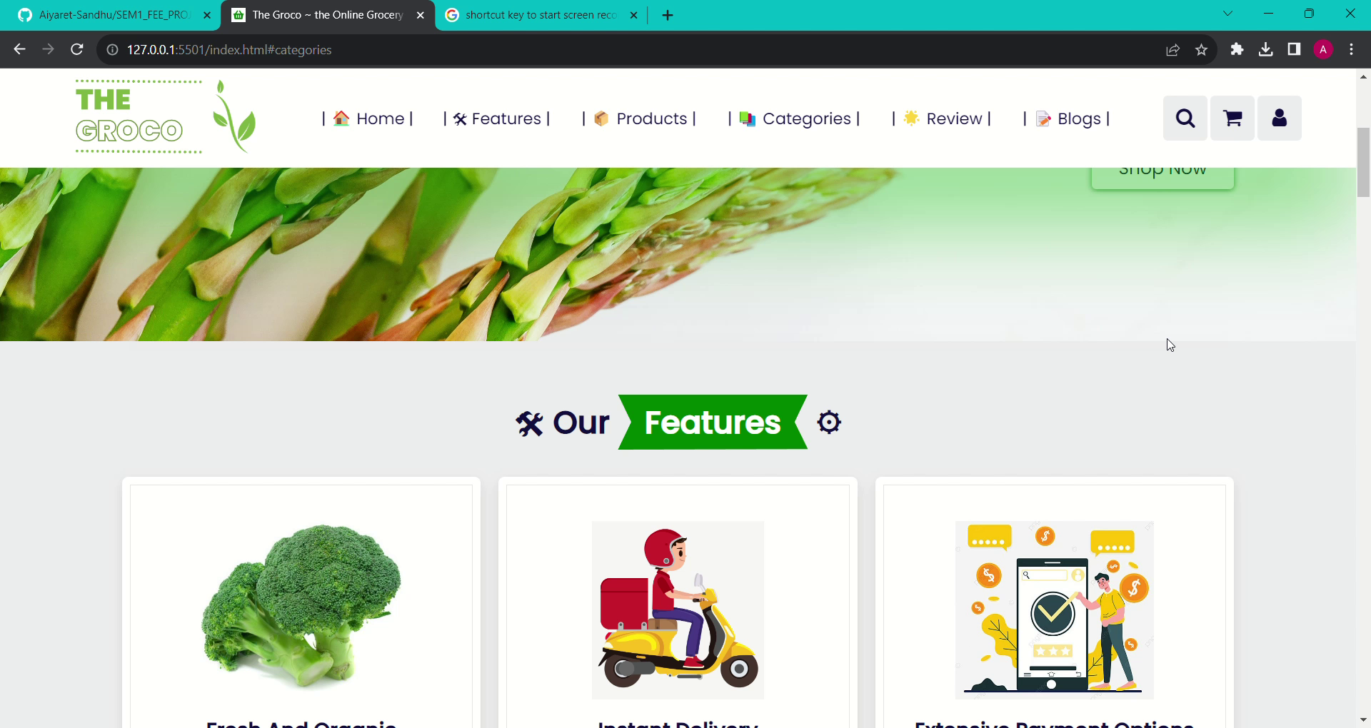
Real Time working of the first page of our project

Slide 9
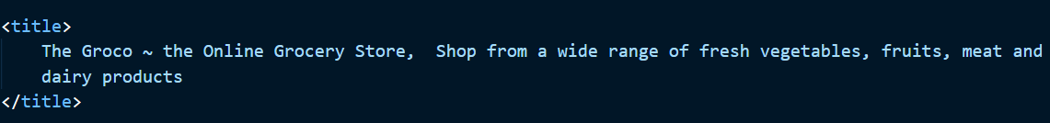

Notice the use of Keywords in description tags , and title

Slide 10
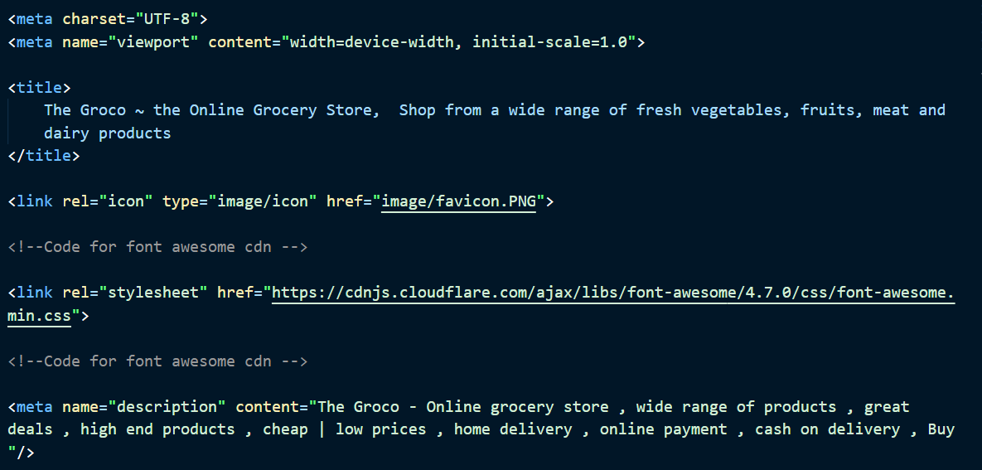
Meta tags : a few meta tags that were used

Slide 11
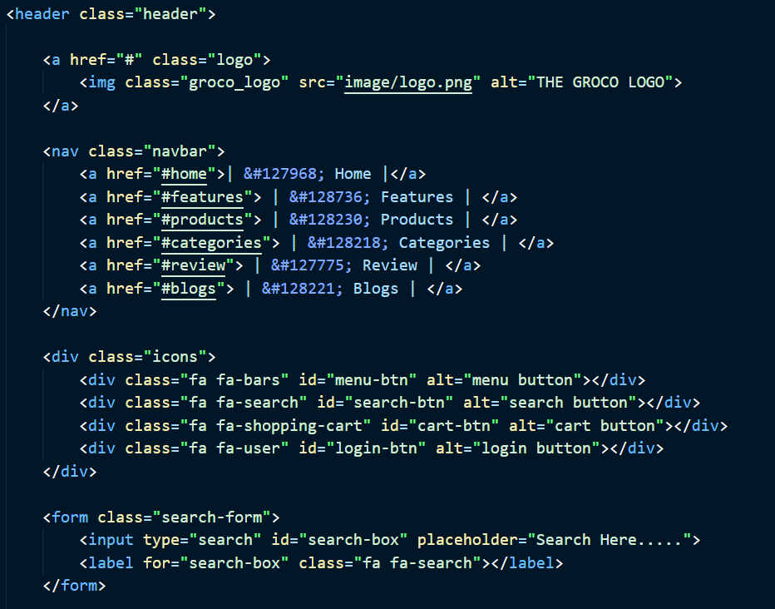
This is the ﻿ part of the home tag html code it symolises the basic structure of the header Notice the use of class , alt and id attributes

Slide 12
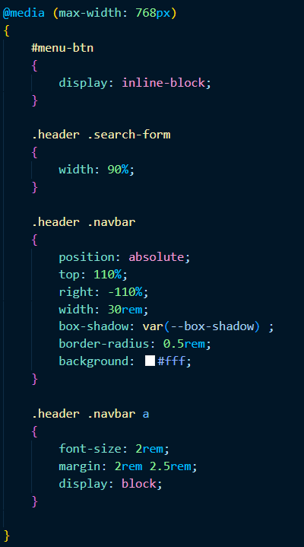
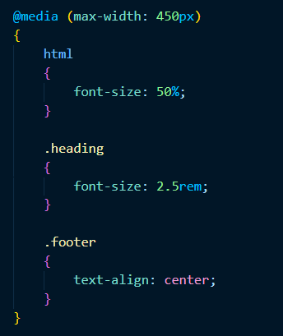
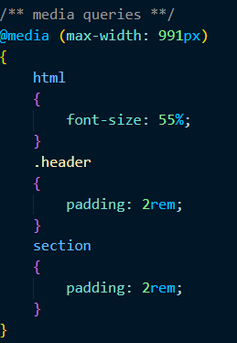
Media queries were used to make the website more mobile friendly and responsive

Slide 13
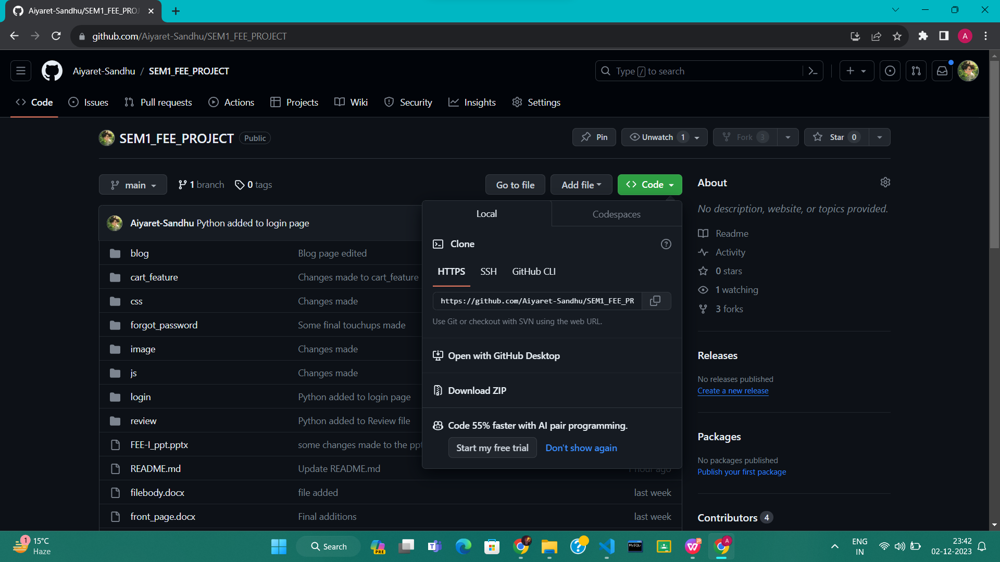
GitHub was used in the project as VLC (Version Control System)

Slide 14
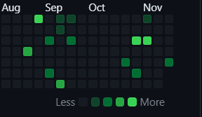

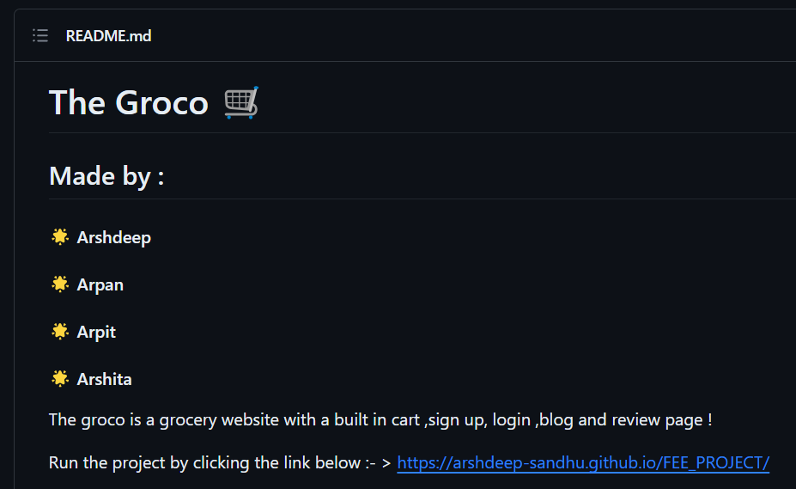
Link to our Repository
https://github.com/Aiyaret-Sandhu/SEM1_FEE_PROJECT.git
Our Readme.md
file contains a local execution link !

Slide 15
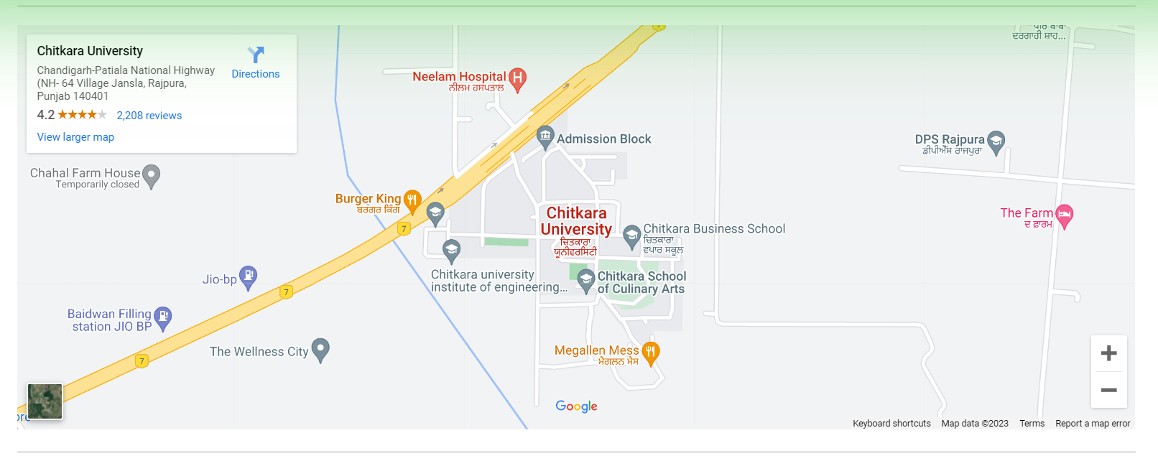
We added a map of our store at the footer as well

Slide 16
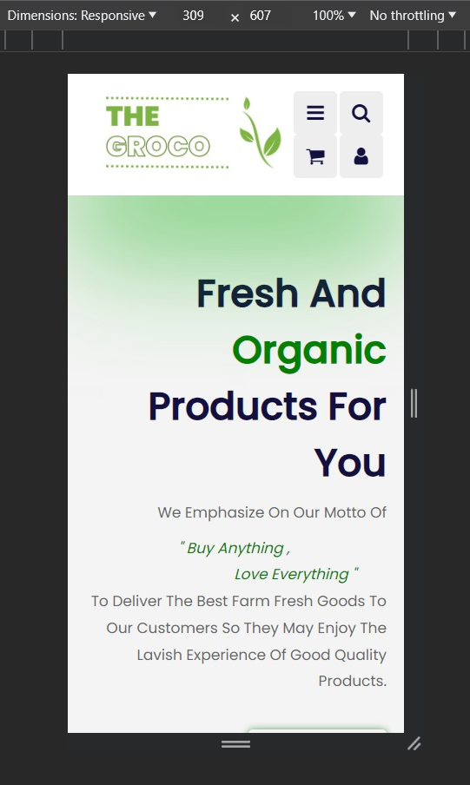
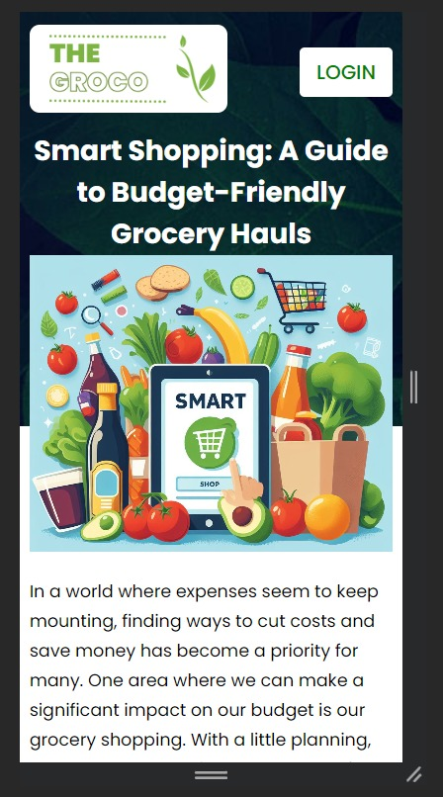
The pages have been designed to be responsive, i.e, they look great on a computer and mobile devices alike !

Slide 17
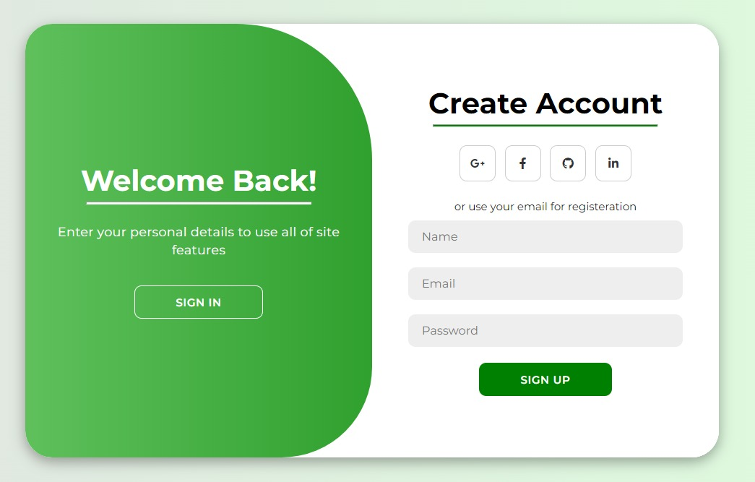
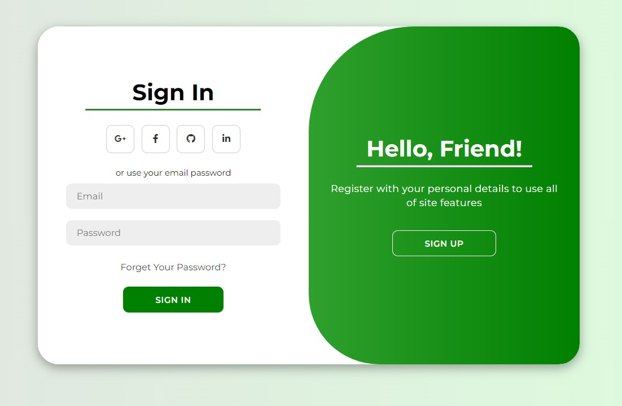
The login pages have been enhanced using Javascript onclick attribute
This single page therefore can work like two. Thus decreasing Website load time.

Slide 18

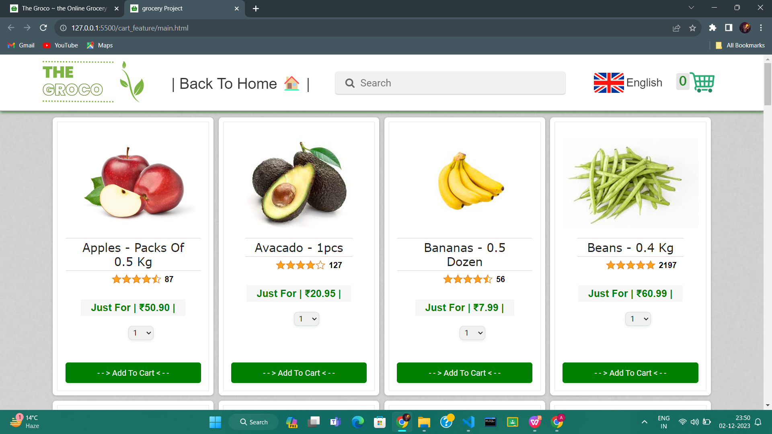
Clicking on the Buy now opens the buying website which further consists of a checkout page, order history page, etc.

Slide 19
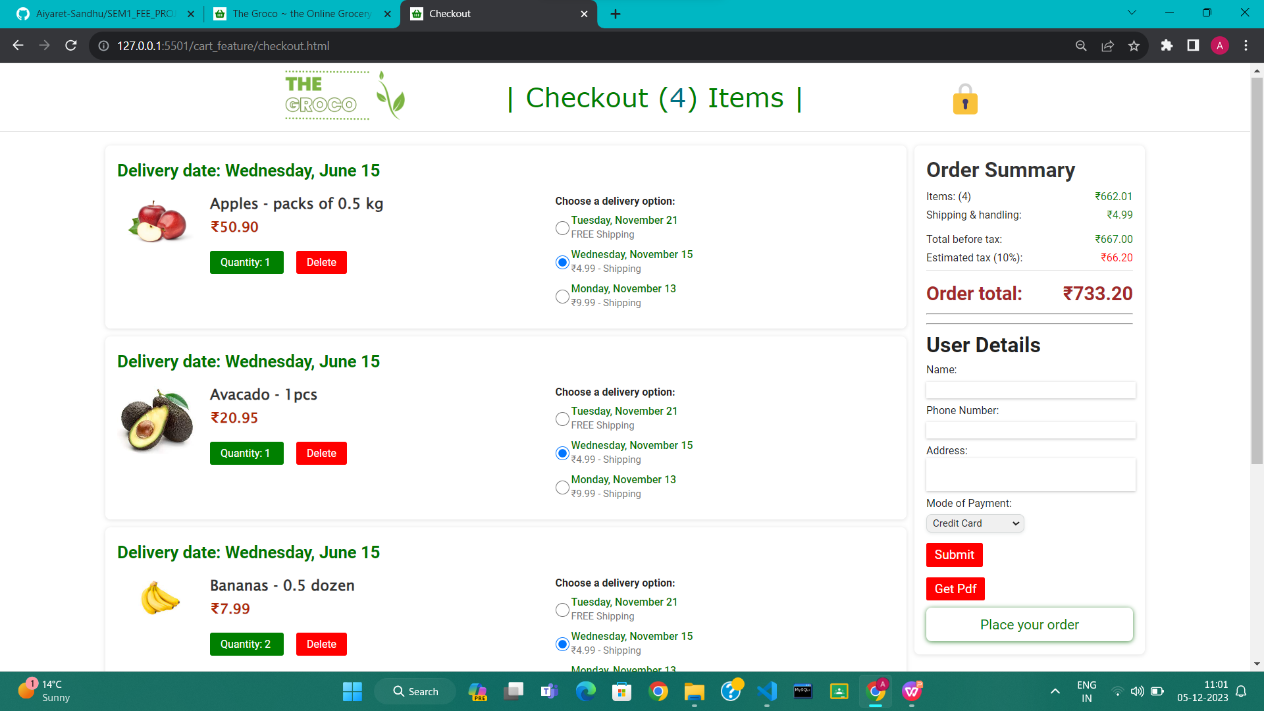

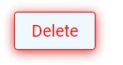
First selecting the products, then clicking on the cart icon opens the enchanced Checkout page which creates a working cart feature which automatically calculates the required cost. with a working delete option . Also there is the user details form

Slide 20
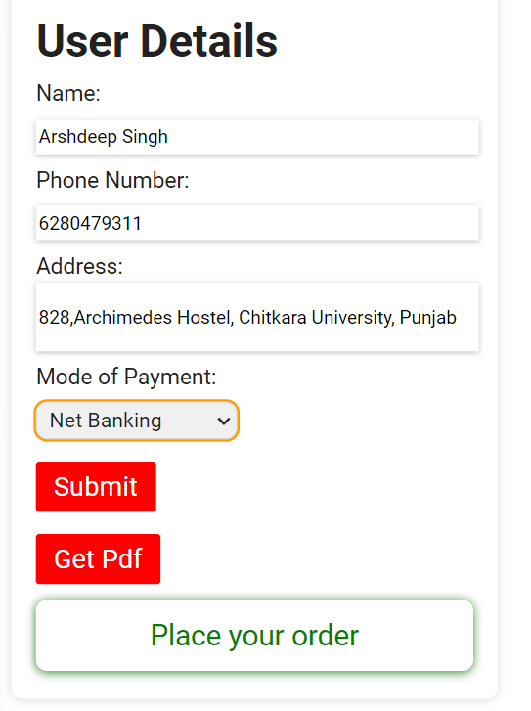
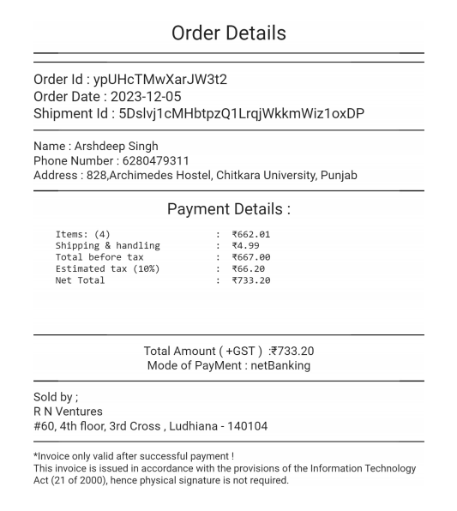
After filling the details, on clicking the SUBMIT button -- > Get pdf Button , downloads the invoice ! . furthurmore on clicking place order , opens the past orders.

Slide 21
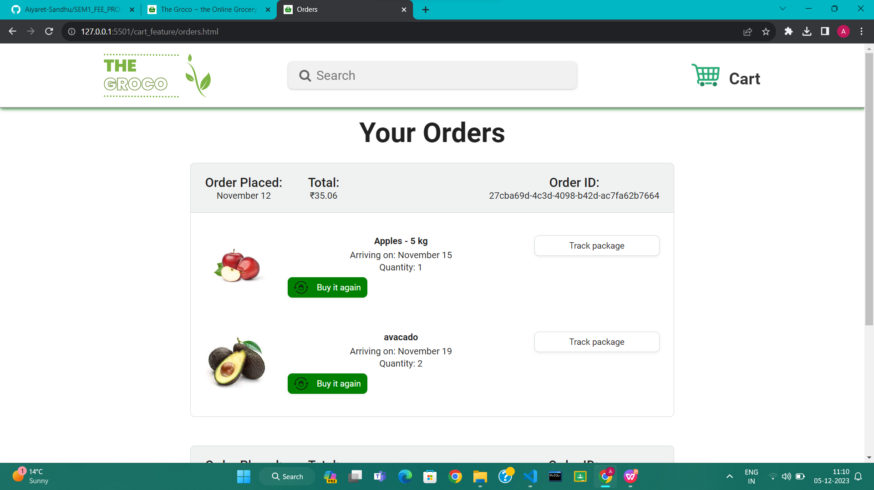
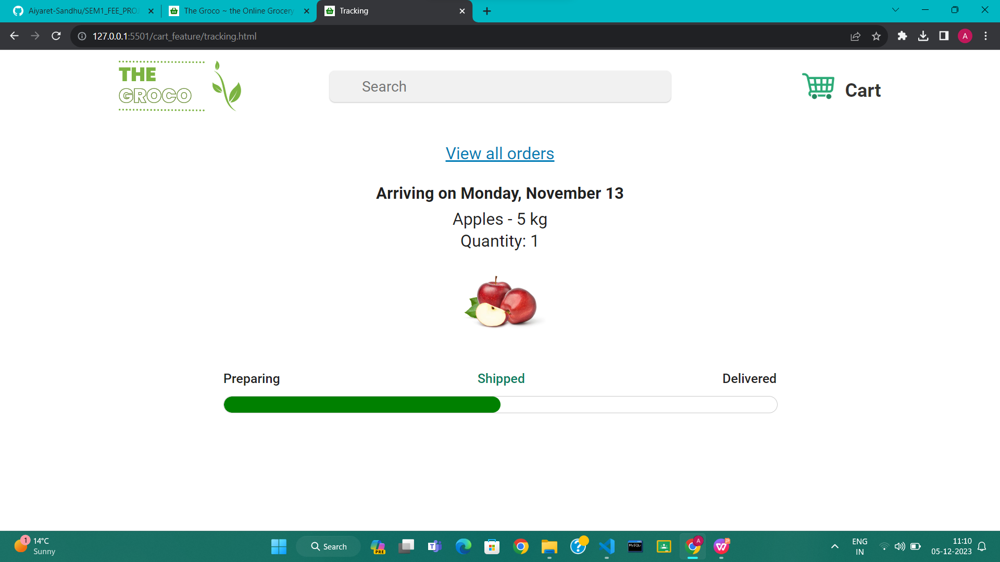
This page shows your previous order and you can also check the tracking status by clicking on the Track Package button.

Slide 22

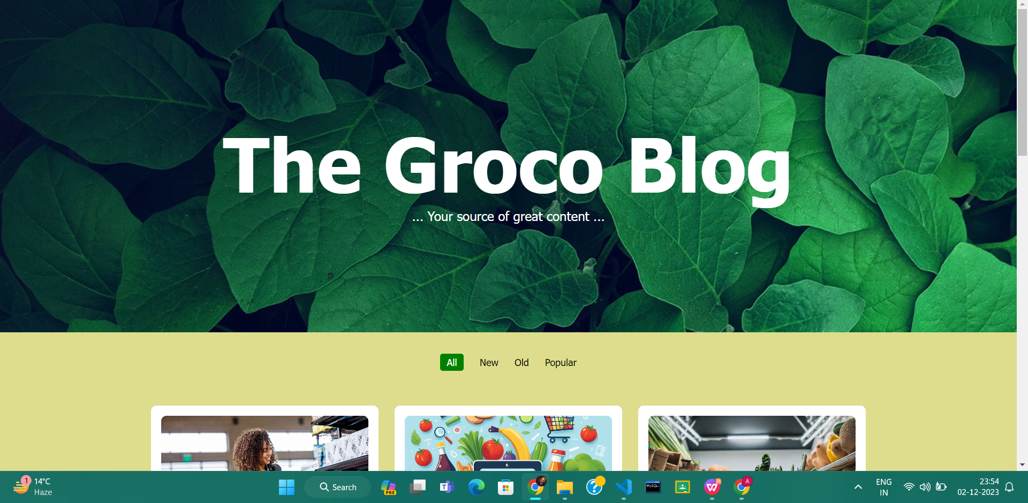
The Read More option at the bottom leads to the blog website containing multiple blogs

Slide 23
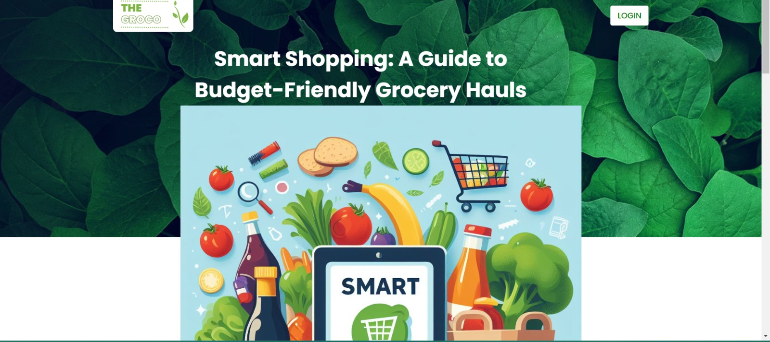
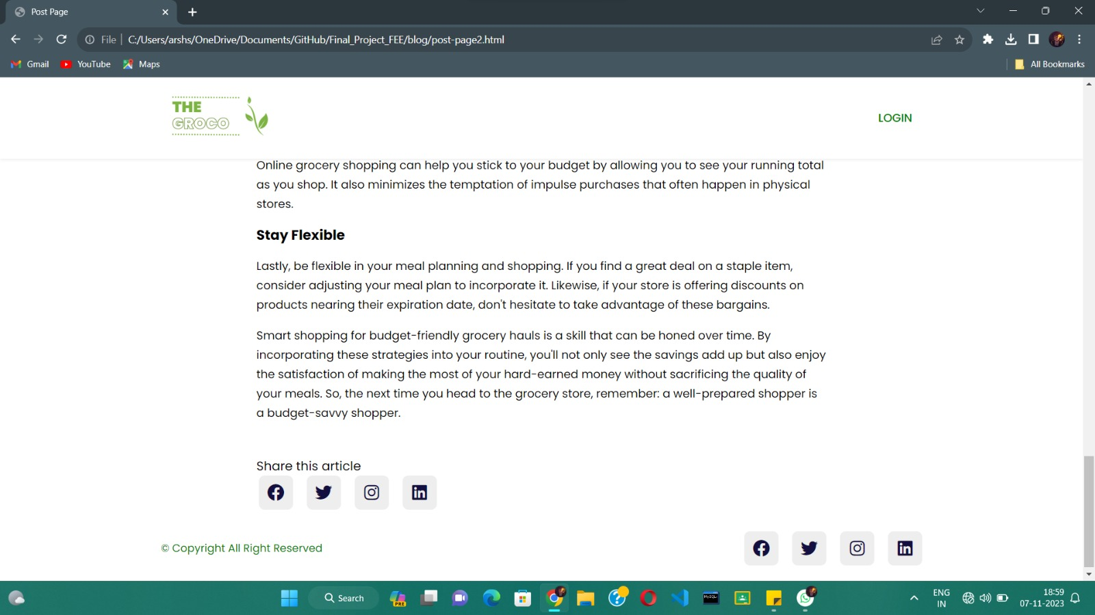
Clicking on any blog results in a new blog page that contains blogs written by trusted users

Slide 24
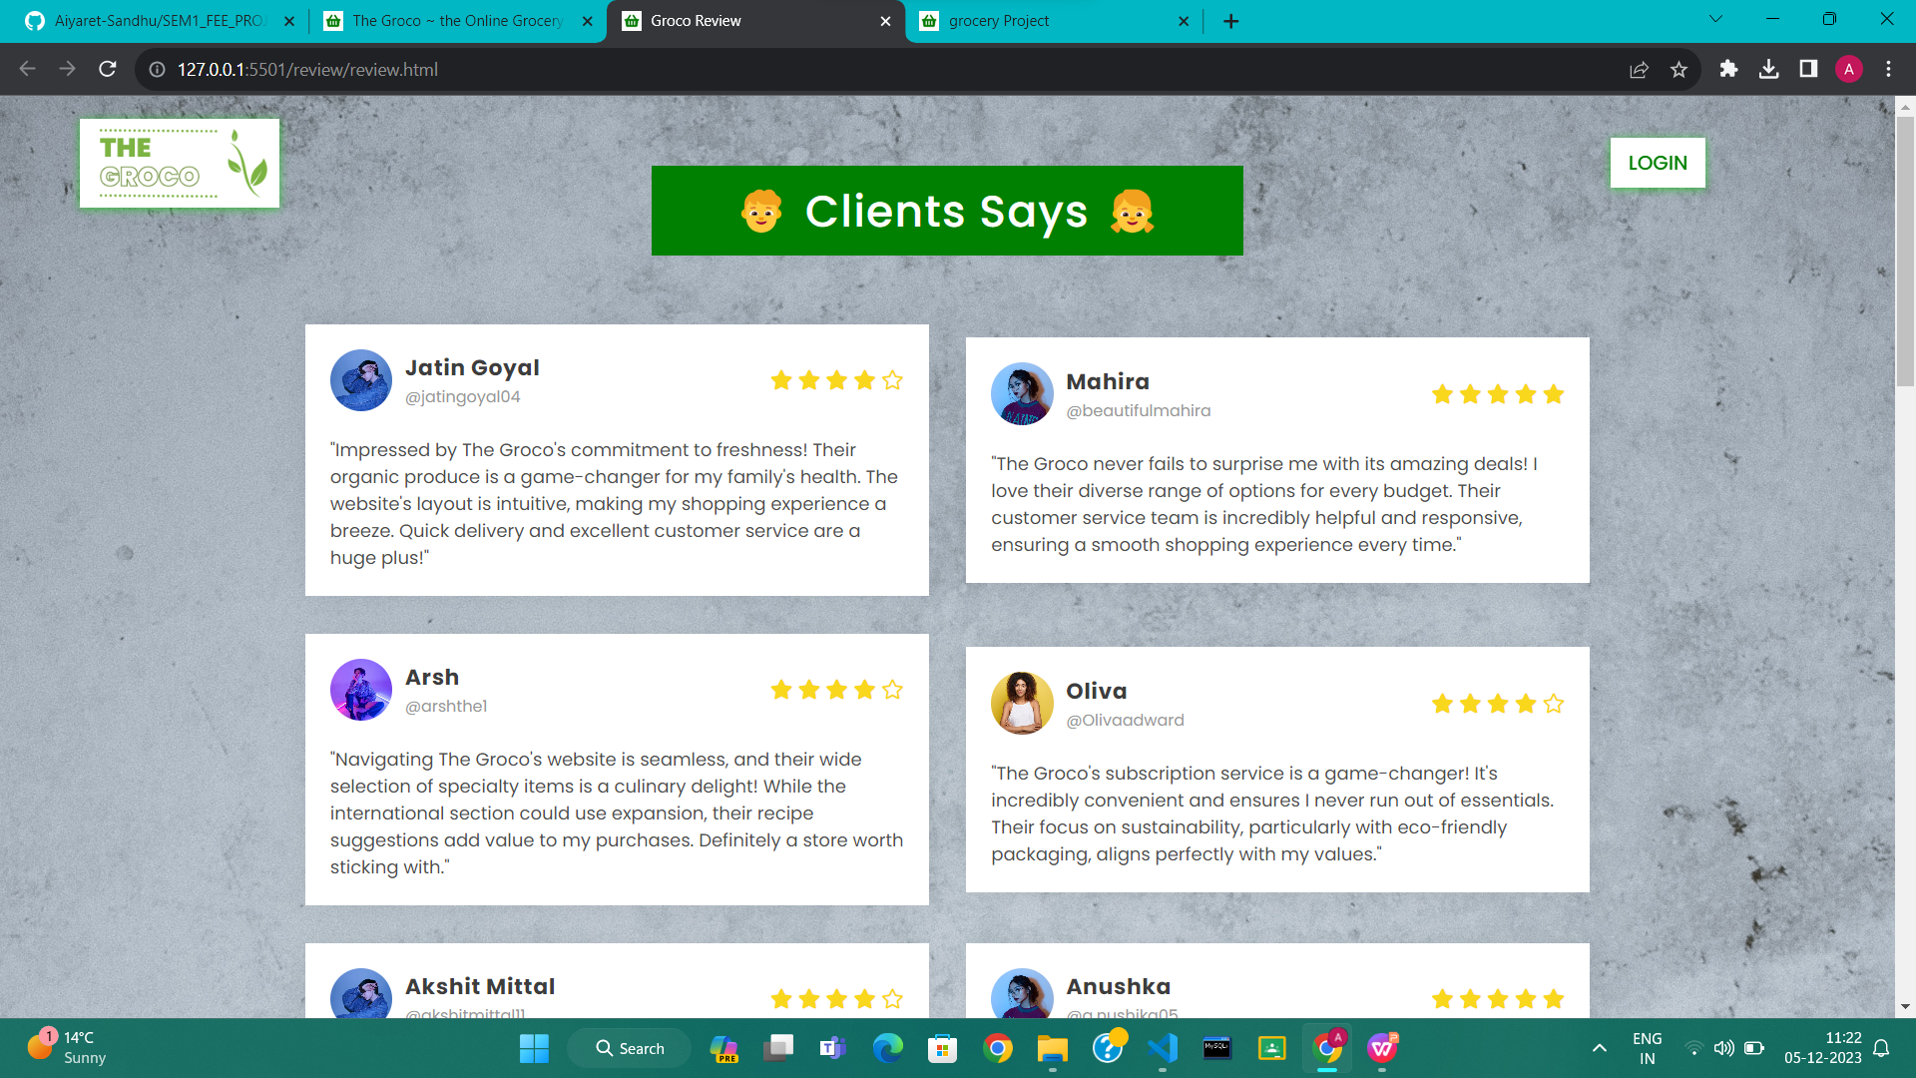
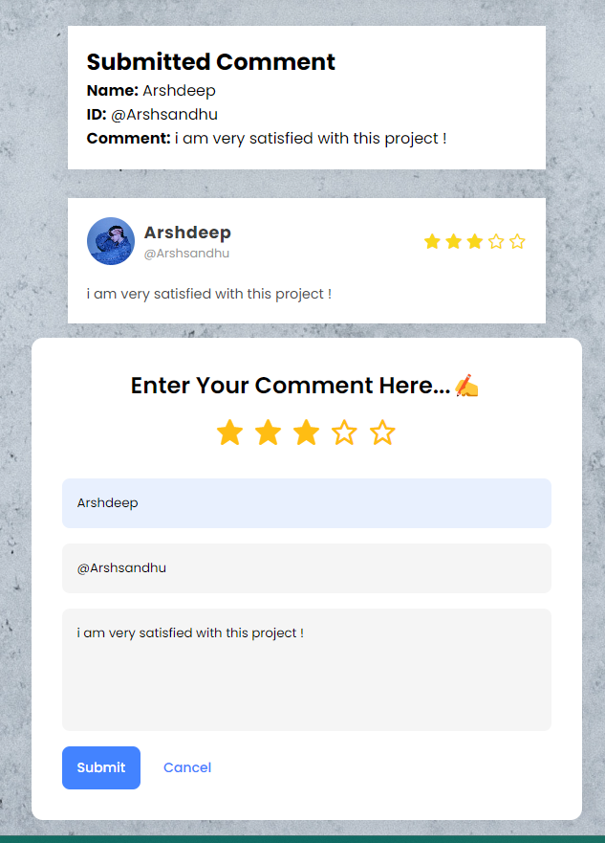
Furthurmore, we have added a user review page that displays user review. where you can add your review as well !

Slide 25

| Bonus Features |
Readmore option
A working cart feature that works on its own
Download pdf option
A sliding effect in our product and our reviews section which slides after approx. 7.5s
Editable review page
Map

Slide 26

| Conclusion |
This Project has been an eyeopener to all the respective members about the world of front-end engineering, e-commerce, and teamwork.
The insight illuminated about the struggle experienced by small e-commerce websites and the importance of a fully devoted workforce

Slide 27

| Future Scope |
The project will soon have :
# A complete backend database
#integration with emerging technologies

Slide 28
| References / Links Used |
https://fonts.google.com/
https://supersimple.dev/
https://swiperjs.com/
https://www.canva.com/create/logos/
https://www.fontawesome.com/

Slide 29
THANK YOU !

